Slide 1
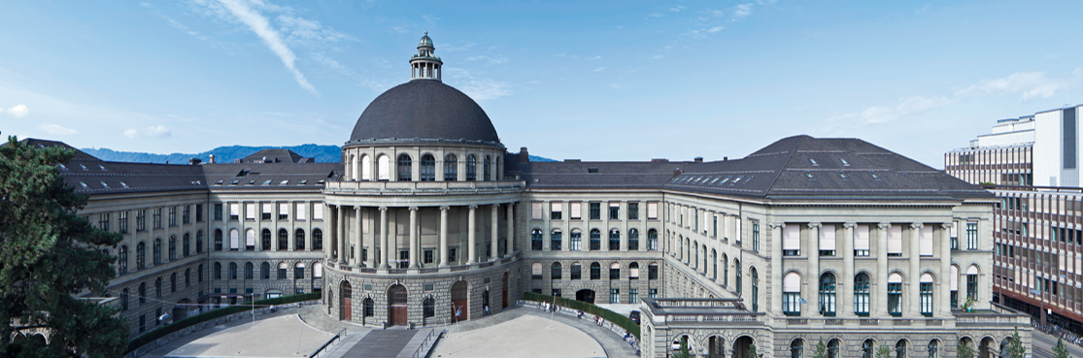
Equal Headway Instability
Project Final Presentation
Modelling and Simulating Social Systems with MATLAB
Maicol Fabbri – Cheuk Wing Edmond Lam

Slide 2
Agenda
Introduction
Model description
Simulation results
Conclusion

Slide 3
Scope of the Project
Urban tram system
No other traffic

Slide 4
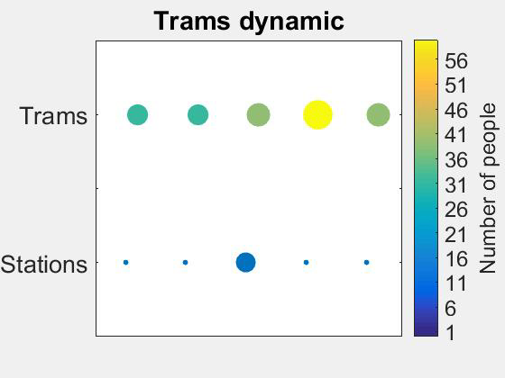
What does equal headway mean?
Regular intervals
Same distance
Follow schedule

Slide 5
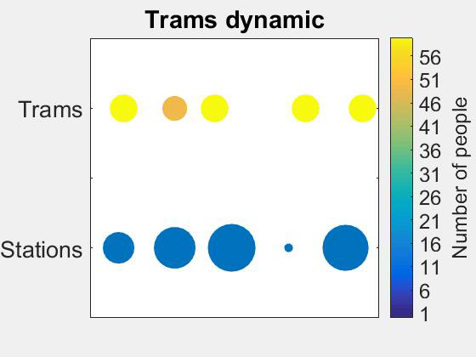
Why do sometimes trams arrive late?
Equal headway is unstable
Larger number of people who wants to get off the tram or board for a certain tram
Platooning effect:
Trams don’t cover uniformly the track anymore
Clusters of trams formed

Slide 6
Research question
Can certain passenger behaviour improve the public transportation efficiency?
Ground idea: a full and delayed tram is often closely followed by an almost empty and on time tram (platooning effect)
→ Instruct people to skip that tram and take the following one under specified conditions
Empty and on-time tram
Full and delayed tram
Station

Slide 7
The model
T
T
T
T
T
1. Create a cyclic track
S
S
S
S
S
2. Add stations
3. Add trams
Number of people who wants to get off the tram is random
Boarding conditions
Trams has to wait a minimum time at each station (so to define a schedule)
When the schedule is not respected → delay
4. Discretize the simulation into time instants
The “people rate” is used to trigger the instability.
Remark: with people rate we refer to the mean of the Poisson distribution
A random number of people arrives at a random station each instant.
Usage of POISSON distribution with a desired mean value for the “people rate”
In each instant of time:
Trams can move a cell
A well-defined number of people can board or get off the tram
5. Make people randomly arrive at the stations
6. Implement tram dynamics
→ Vary the number of people arriving at the stations

Slide 8
Boarding Conditions
Case without people behaviour (control case), passengers can board if
People on the tram who want to get off have got off
The tram is not full
Case With people behaviour, passengers can board if
People on the tram who want to get off have got off
The tram is not full
The instruction to skip the tram is not issued

Slide 9
When to skip a tram?
We instruct people to skip a tram if:
The incoming tram is delayed; and
The previous tram at this station was not skipped; and
The following tram will arrive in half of a tram period
next tram is coming soon
Example: if a tram takes 10 time instants to travel between two stations → half of tram period is 5
Station
5 time instants
Station
10 times instants length

Slide 10
Simulations and result parameters
In the last instant of time, the values collected are:
Average delay of all trams
Average number of people waiting in all the stations
Parameters chosen for the simulation:
Track length=50 cells
Trams=5
Stations=5, equally spaced
Tram capacity=60 people
Boarding rate=20 people/instant
Station waiting time= 3 instants
Time instants=360
People rate= 1:1:40
Note: 50 simulations are performed with the same boundary conditions and the results averaged
→ elimination of aleatoric effects

Slide 11
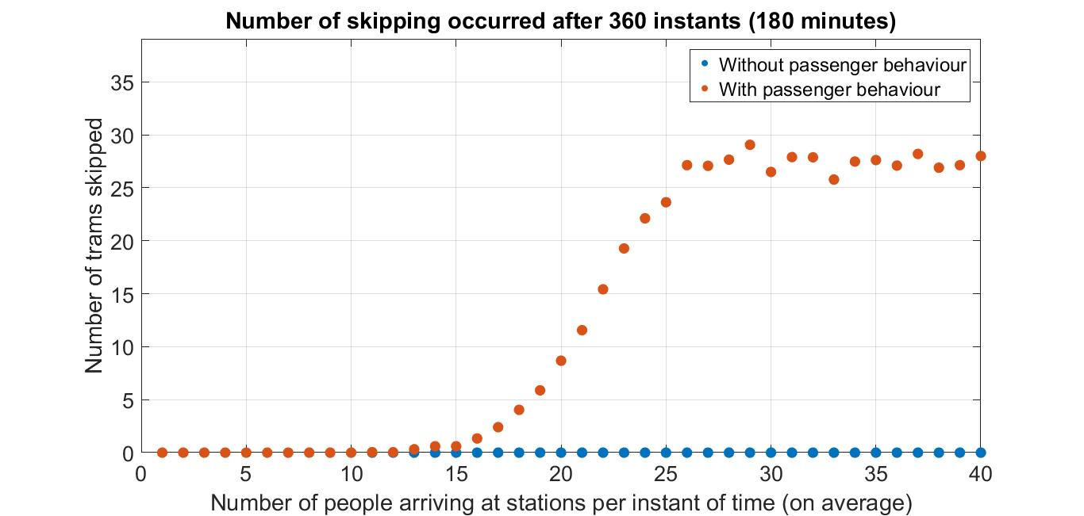
Results – influence of people behaviour
3 Zones
Inactive zone
Active zone
Saturation zone

Slide 12
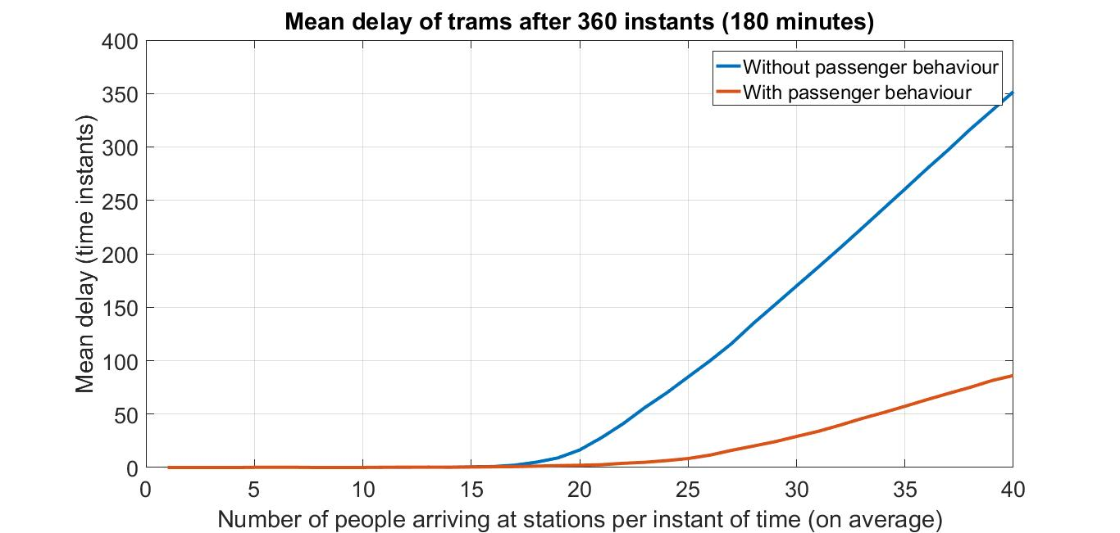
Results – Tram delay
People behaviour drastically reduces tram delay

Slide 13
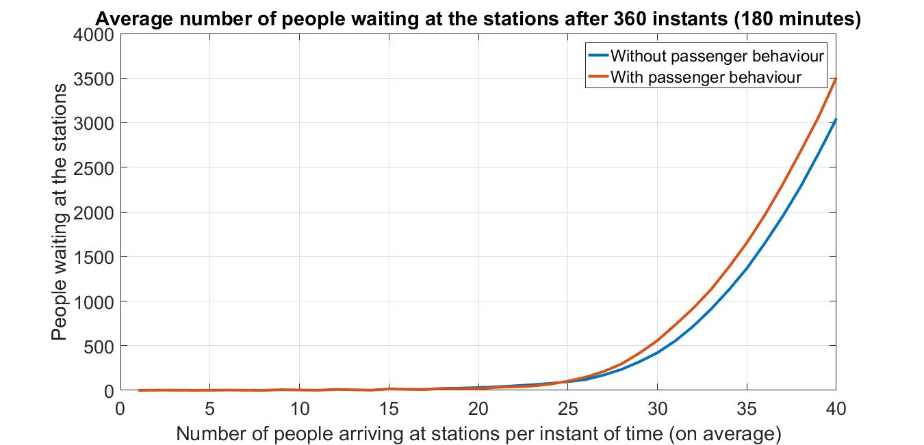

Results – People waiting at the stations
In the “saturation zone”, the people waiting at the stations are more → the skip of a tram leads to less people carried around
Zoom in the “active zone”

Slide 14
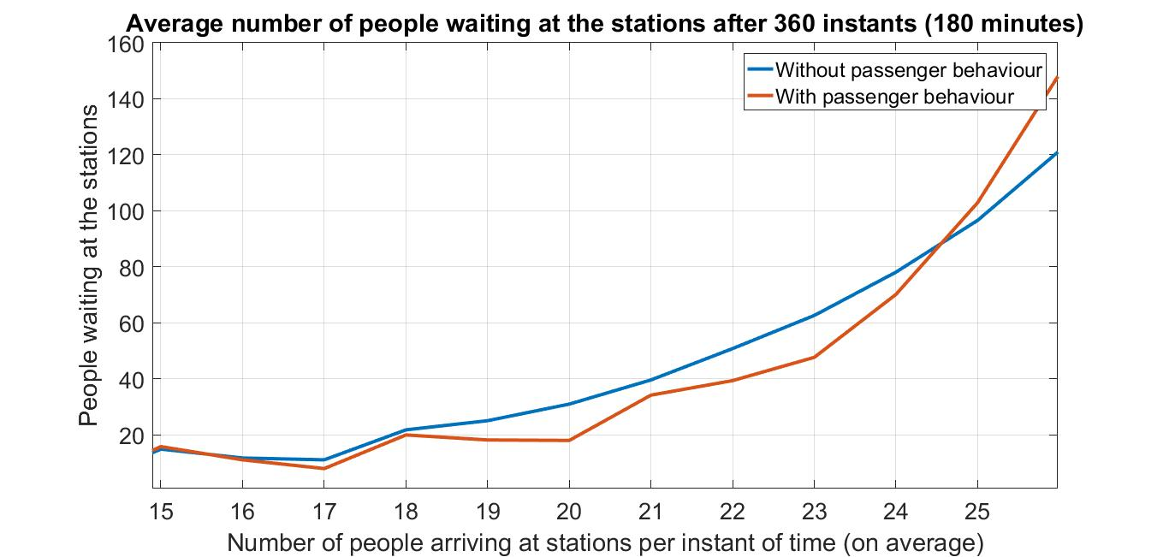
Results – People waiting at the stations – Active zone
People behaviour makes the trams better cover the track → in the active zone, transportation efficiency is improved
Turning points

Slide 15
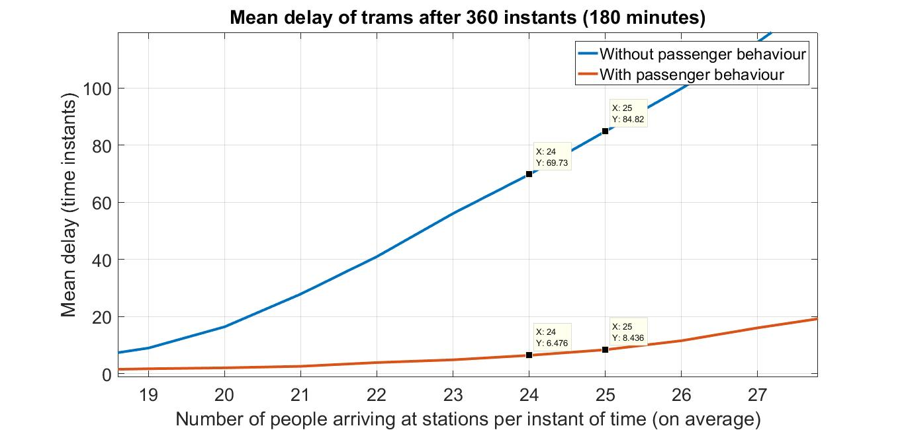
Results – Trams delay – Active zone
X: 25
Y: ~85
X: 24
Y: ~70
Reduction of ~90%
Reduction of ~90%
X: 24
Y: ~6.5
X: 24
Y: ~8.5

Slide 16
Conclusion
People behaviour can have a huge positive influence in the public transportation efficiency
Choosing to wait few minutes more can brings benefits to all the other passengers
Dilemma: maximizing own profit or cooperate for a collective gain?
Remark: the numerical values shown strongly depends on the boundary conditions imposed. Nevertheless, several tries with different boundary conditions and parameters have shown the same positive results

Slide 17

Thank you for your attention

